Slide 1
OrganiStation: Cloud-native Organisation management platform
Mahesh D

Slide 2
Goals
Infrastructure as Code
Containerized Deployment
Secure Networking
Automated Provisioning
Scalable Architecture

Slide 3
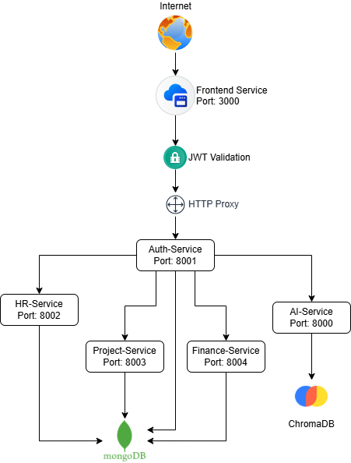
Application architecture

Slide 4
Security Measures Taken
VNet Separation & Peering
Private Endpoints
Traffic Filtering
Private DNS Integration
Virtual Network Integration

Slide 5
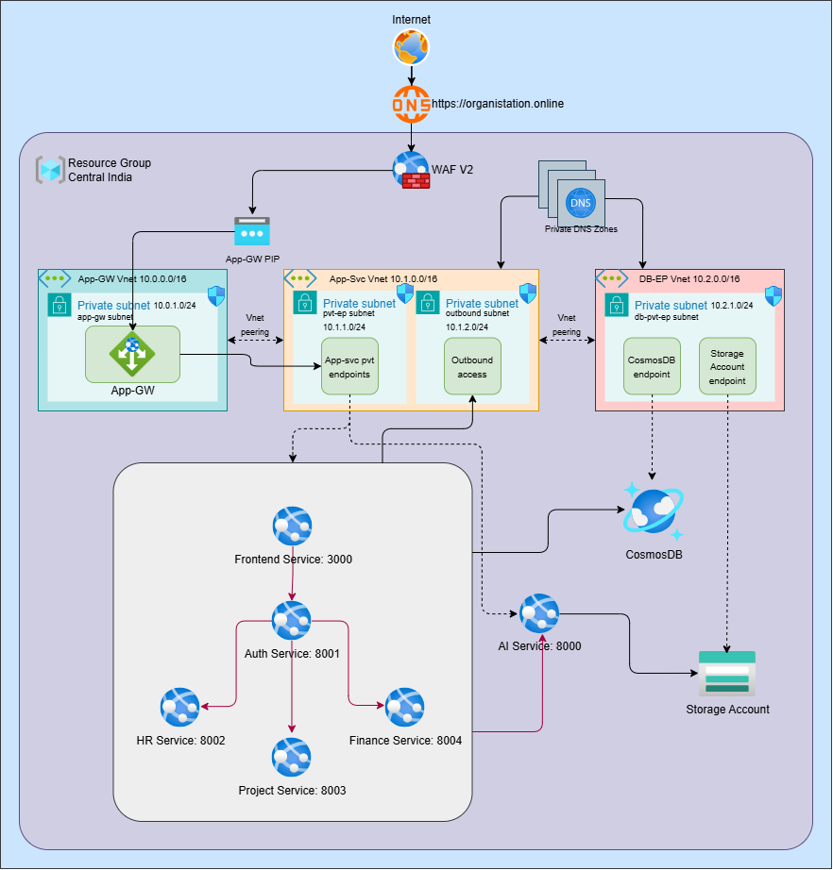
Cloud infrastructure

Slide 6
Azure services used
Resource group
Virtual networks
Subnets
NSGs
WAF v2
Application gateway
App Service
Private DNS Zones
CosmosDB
StorageAccount

Slide 7
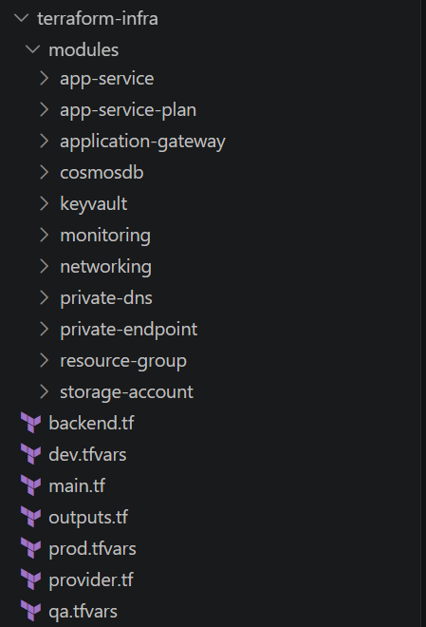
Terraform Folder Structure

Slide 8
Thank You

